Slide 1


Resume

Slide 2

Effective resume vs Poor resume

Slide 3
Effective resume | Poor resume
Clear Structure | Chaotic Structure
Organized sections (Contact Info, Summary, Experience, Education, Skills) | Disorganized sections
Easy-to-follow layout | Cluttered layout and lack of clear hierarchy

Slide 4
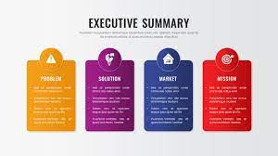
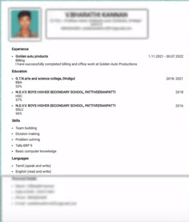



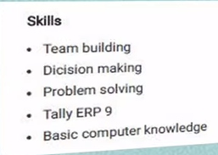




POOR RESUME COMPONENTS
GUIDELINES TO OMIT POOR RESUME COMPONENTS
Executive summary should be clear – that contains experience, skill, position you are applying for
Never put your photograph of yourself on the resume
Don’t mention your home address.
Mention your e-mail id and your phone number, city and state you are living.
Segregate your skill in a different category. Tally and other technical skills should mention under ‘TECHNOLOGY SKILL’ category.
In EXPERIENCE part, mention what are the roles you played and express your achievement of the role in bulletin format
Avoid spelling Mistake – Use spell check feature in MS Word
Notes:
Never put your photograph of yourself on the resume
Don’t mention your home address.
Mention your e-mail id and your phone number, city and state you are living.
Avoid spelling Mistake – Use spell check feature in MS Word
Segregate your skill in a different category. Tally and other technical skills should mention under ‘TECHNOLOGY SKILL’ category.
Executive summary should be clear – that contains experience, skill, position you are applying for
In EXPERIENCE part, mention what are the roles you played and express your achievement of the role in bulletin format

Slide 5

Effective resume | Poor resume
Strong Summary/Objective | Weak Summary/Objective
Concise summary of qualifications | Vague or irrelevant summary
Immediate impact on the reader | Fails to grab the employer's attention

Slide 6
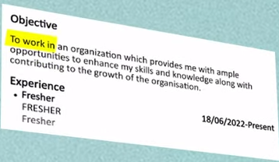
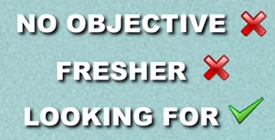

CONTENT SHOULD BE INCLUDED
POOR OBJECTIVE
1. A clear objective contains
Your education – recent degree
Your skill
Your experience
What position your are applying for?
2. If you are a fresher,
Details about internship during your school/college

Slide 7
Effective resume | Poor resume
Targeted Content | Generic Content
Tailored to the specific job and company | Generic skills and responsibilities
Relevant skills and experiences highlighted | Lack of customization for the desired position

Slide 8
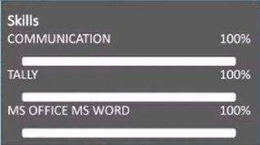
SKILLS
In skill portion of your resume,
No need to mention your communication skills
MS Office and TALLY should come under ‘TECHNOLOGY SKILL’
2. If you are a fresher,
Details about internship during your school/college should come under ‘EXPERIENCE’

Slide 9
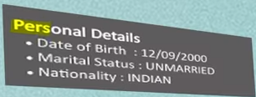


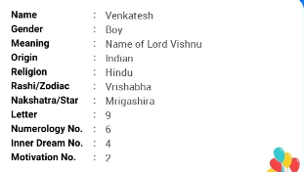

PERSONAL DETAILS
Don’t menion your DOB
Father name
Mother name
Sign
Nakshathra
Gothra
Don’t express Marital status
Don’t state your Marital status, DOB and nationality

Slide 10
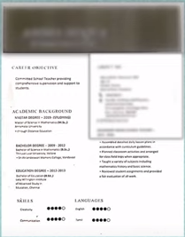
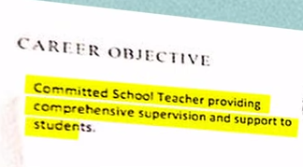

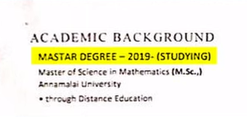
POOR RESUME COMPONENTS
GUIDELINES TO OMIT POOR RESUME COMPONENTS
Objective on left side, about me on right side – completely wrong template. Avoid ‘ABOUT ME’ section.
Below format is enough.
YOUR NAME
Current Position
Information should flow from TOP to BOTTOM
Current profession shall be mentioned as ‘EXECUTIVE SUMMARY’.
Academic background should come at he bottom or in the middle
ABOUT ME

Slide 11
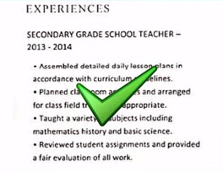
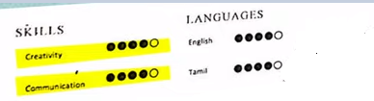
GOOD RESUME COMPONENTS
Experience is elaborated clearly
Info graphics are utilized well
✓

Slide 12
A GOOD RESUME CONTAINS
Remove your photo
Don’t mention DOB and home address
Segregate your skills
Clear details about you role and responsibilities in ‘EXPERIENCE’ part
Clear objective
The position you are applying for
Previous experience
Clear skill set
Not bearing personal details
No communication address column
Full of content regarding the position you are applying
Information should flow from top to bottom
Start your resume with your EXECUTIVE SUMMARY, EXPERIENCE,ACADEMIC BACKGROUND, CONTACT DETAILS and Add references at the end

Slide 13


Slide 14
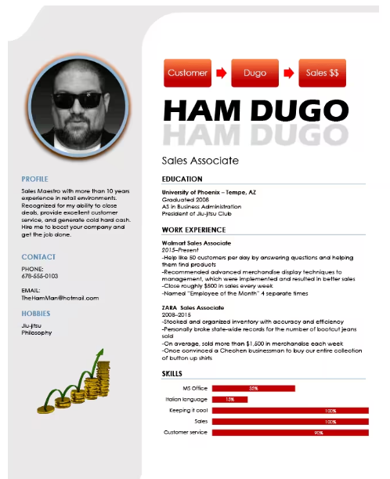
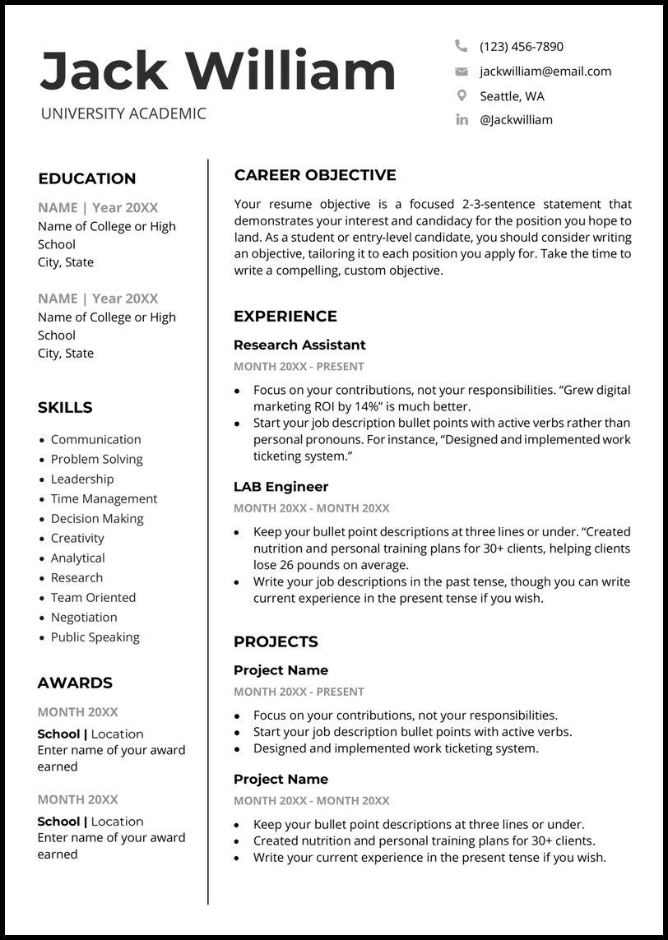

Slide 15
Effective resume | Poor resume
Quantifiable Achievements | Lack of Achievements
Accomplishments with measurable results | Focuses on duties rather than accomplishments
Demonstrates impact and contributions | Misses opportunities to stand out

Slide 16
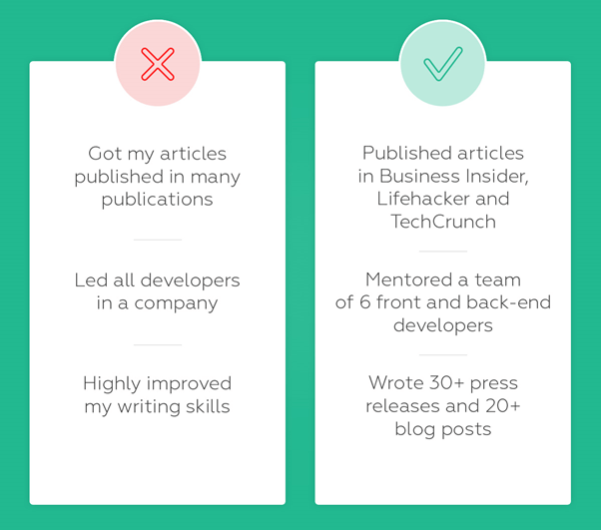

Slide 17
Effective resume | Poor resume
Relevant Work Experience | Irrelevant Work Experience
Clearly stated job roles and responsibilities | Unrelated or outdated job roles
Highlights experiences directly related to the desired position | Doesn't showcase the candidate's fit for the job

Slide 18
Effective resume | Poor resume
Education and Credentials | Overemphasis on Education
Emphasizes relevant degrees, certifications, and training | Excessive focus on education without tying it to the job
Demonstrates qualifications for the role | May signal lack of practical experience

Slide 19
Effective resume | Poor resume
Concise and Focused | Excessive Length
Avoids unnecessary details and filler content | Too much information or irrelevant details
Makes a strong impression in a short amount of time | Buries key qualifications under a pile of text

Slide 20
Effective resume | Poor resume
Clear Formatting | Inconsistent Formatting
Consistent font, spacing, and bullet points | Mix of fonts, sizes, and formatting choices
Easy to skim and read | Creates a messy and unprofessional appearance

Slide 21
Effective resume | Poor resume
Error-Free | Typos and Errors
Carefully proofread for grammar and spelling | Grammar and spelling mistakes
Professional presentation | Reflects a lack of attention to detail and professionalism

Slide 22
Roll no 24BDS0365 TO 24BDS0388 | Roll no 24BDS0389 TO 24BDS0416 | Roll no 24BDS0417 TO 24BDS0445, 24BKT0001
B.Tech CSE in VIT Vellore, M.Tech CSE in IITM | B.Tech CSE in VIT Vellore, M.Tech CSE in IITM | B.Tech CSE in VIT Vellore, M.Tech CSE in IITM
Applying for Chief Engineer post in Face book | Applying for CEO post in INTEL.INC | Applying for Executive Director in Google
Worked 10 years as deputy Chief engineer in oracle | Worked 10 years as Chief engineer in Face book | Worked 10 years as Deputy Chief Engineer in Apple
Google what are the skills required for deputy Chief engineer | Google what are the skills required for CEO | Google what are the skills required for Executive Director

Slide 23
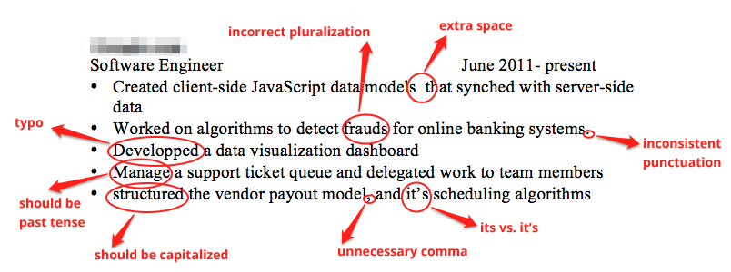

Slide 24
QUESTION 1
What is a key characteristic of an effective resume?
Chaotic Structure
Clear Structure
Disorganized sections
Cluttered layout
Notes:
ANS: B

Slide 25
QUESTION 2
What makes a strong resume summary/objective?
1. Vague or irrelevant summary
2. Excessive details
3. Weak Summary/Objective
4. Concise summary of qualifications
Notes:
ANS: D

Slide 26
QUESTION 3
What is essential for clear formatting on a resume?
Mix of fonts, sizes, and formatting choices
Random layout
Inconsistent sections
Consistent font, spacing, and bullet points
Notes:
ANS: D

Slide 27
QUESTION 4
Which of the following best describes a poor resume layout?
Easy-to-follow layout
Cluttered layout and lack of clear hierarchy
Clear sections for each category
Consistent formatting
Notes:
ANS:B

Slide 28
QUESTION 5
Which type of content should be avoided in a targeted resume?
1. Generic skills and responsibilities
2. Relevant skills and experiences
3. Customized job roles
4. Specific achievements
Notes:
ANS: A

Slide 29
Thank You

